Slide 1

COMP90018
Mobile Computing Systems Programming
WEEK 4 – Sensors
Weiwei Jiang
weiwei.jiang@student.unimelb.edu.au

Slide 2
1
Sensor
2
Barometer
3
Compass
4
Location
CONTENTS

Slide 3

Sensor

Slide 4
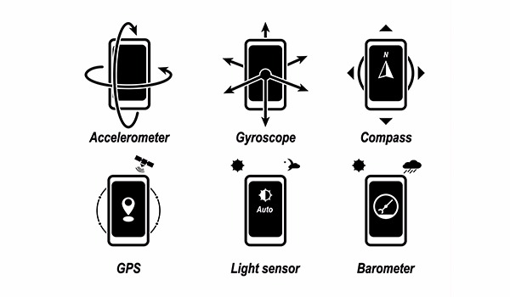
Sensor
Most Android-powered devices have built-in sensors that measure motion, orientation, and various environmental conditions.
https://developer.android.com/guide/topics/sensors/sensors_overview

Slide 5
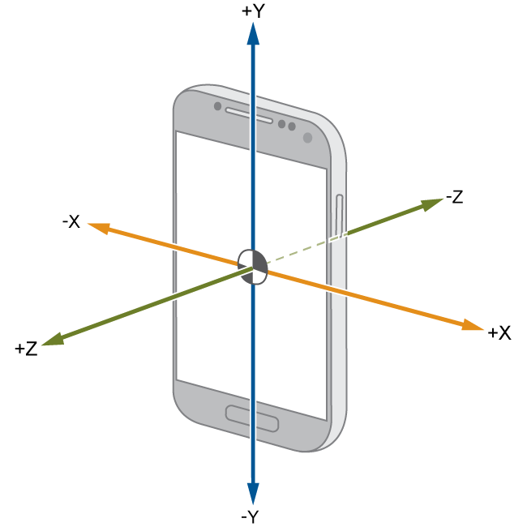
Sensor – Motion Sensors
Motion sensors
These sensors measure acceleration forces and rotational forces along three axes, include
Accelerometers
Gravity sensors
Gyroscopes
Rotational vector sensors
https://developer.android.com/guide/topics/sensors/sensors_motion.html

Slide 6
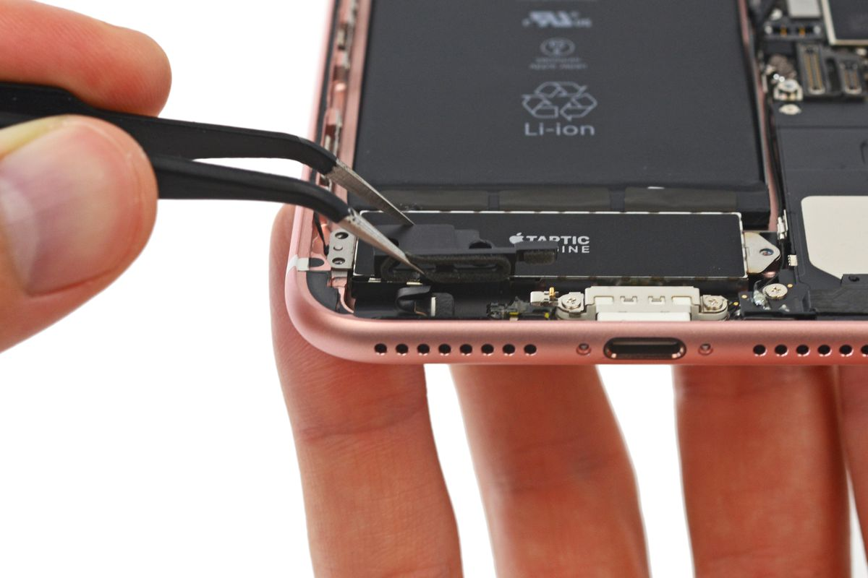
Sensor – Environmental sensors
Environmental sensors
These sensors measure various environmental parameters, include
Ambient air temperature
Illuminance (light)
Ambient air pressure
Ambient humidity
Device temperature
https://developer.android.com/guide/topics/sensors/sensors_environment.html

Slide 7
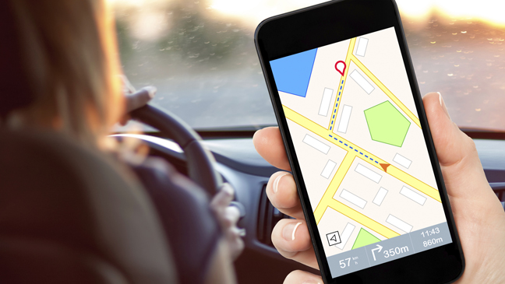
Sensor – Position sensors
Position sensors
These sensors measure the physical position of a device, include
Orientation sensors
Magnetometers
https://developer.android.com/guide/topics/sensors/sensors_position.html

Slide 8
Barometer
- Read sensor

Slide 9
Barometer
A barometer is a scientific instrument that is used to measure air pressure in a certain environment. Pressure tendency can forecast short term changes in the weather.

Slide 10
Barometer Sensor
Barometers are used for monitoring the ambient air pressure in hPa (or mbar).
https://developer.android.com/reference/android/hardware/Sensor.html#TYPE_PRESSURE

Slide 11
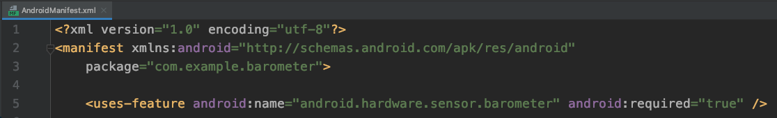
Barometer – permission
AndroidManifest.xml

Slide 12
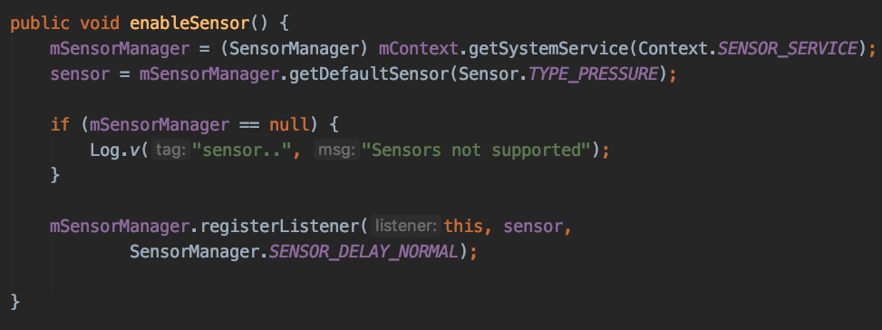
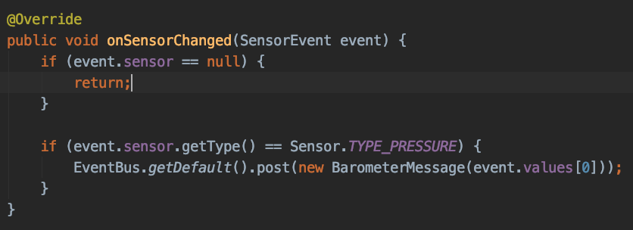
Barometer – get sensor data
Barometer.java

Slide 13
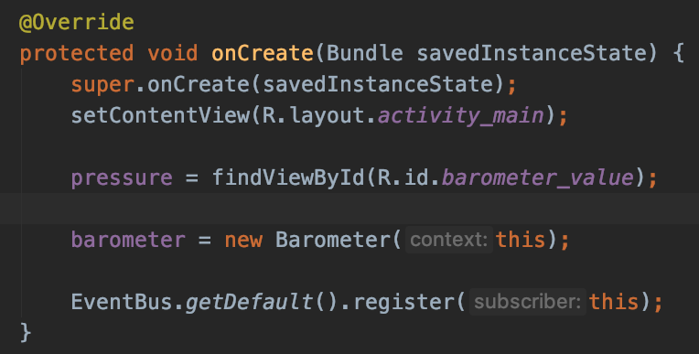
Barometer – get sensor data
MainActivity.java

Slide 14
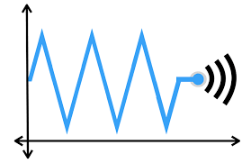
SensorEventListener
Used for receiving notifications from the SensorManager when there is new sensor data.
https://developer.android.com/reference/android/hardware/SensorEventListener

Slide 15
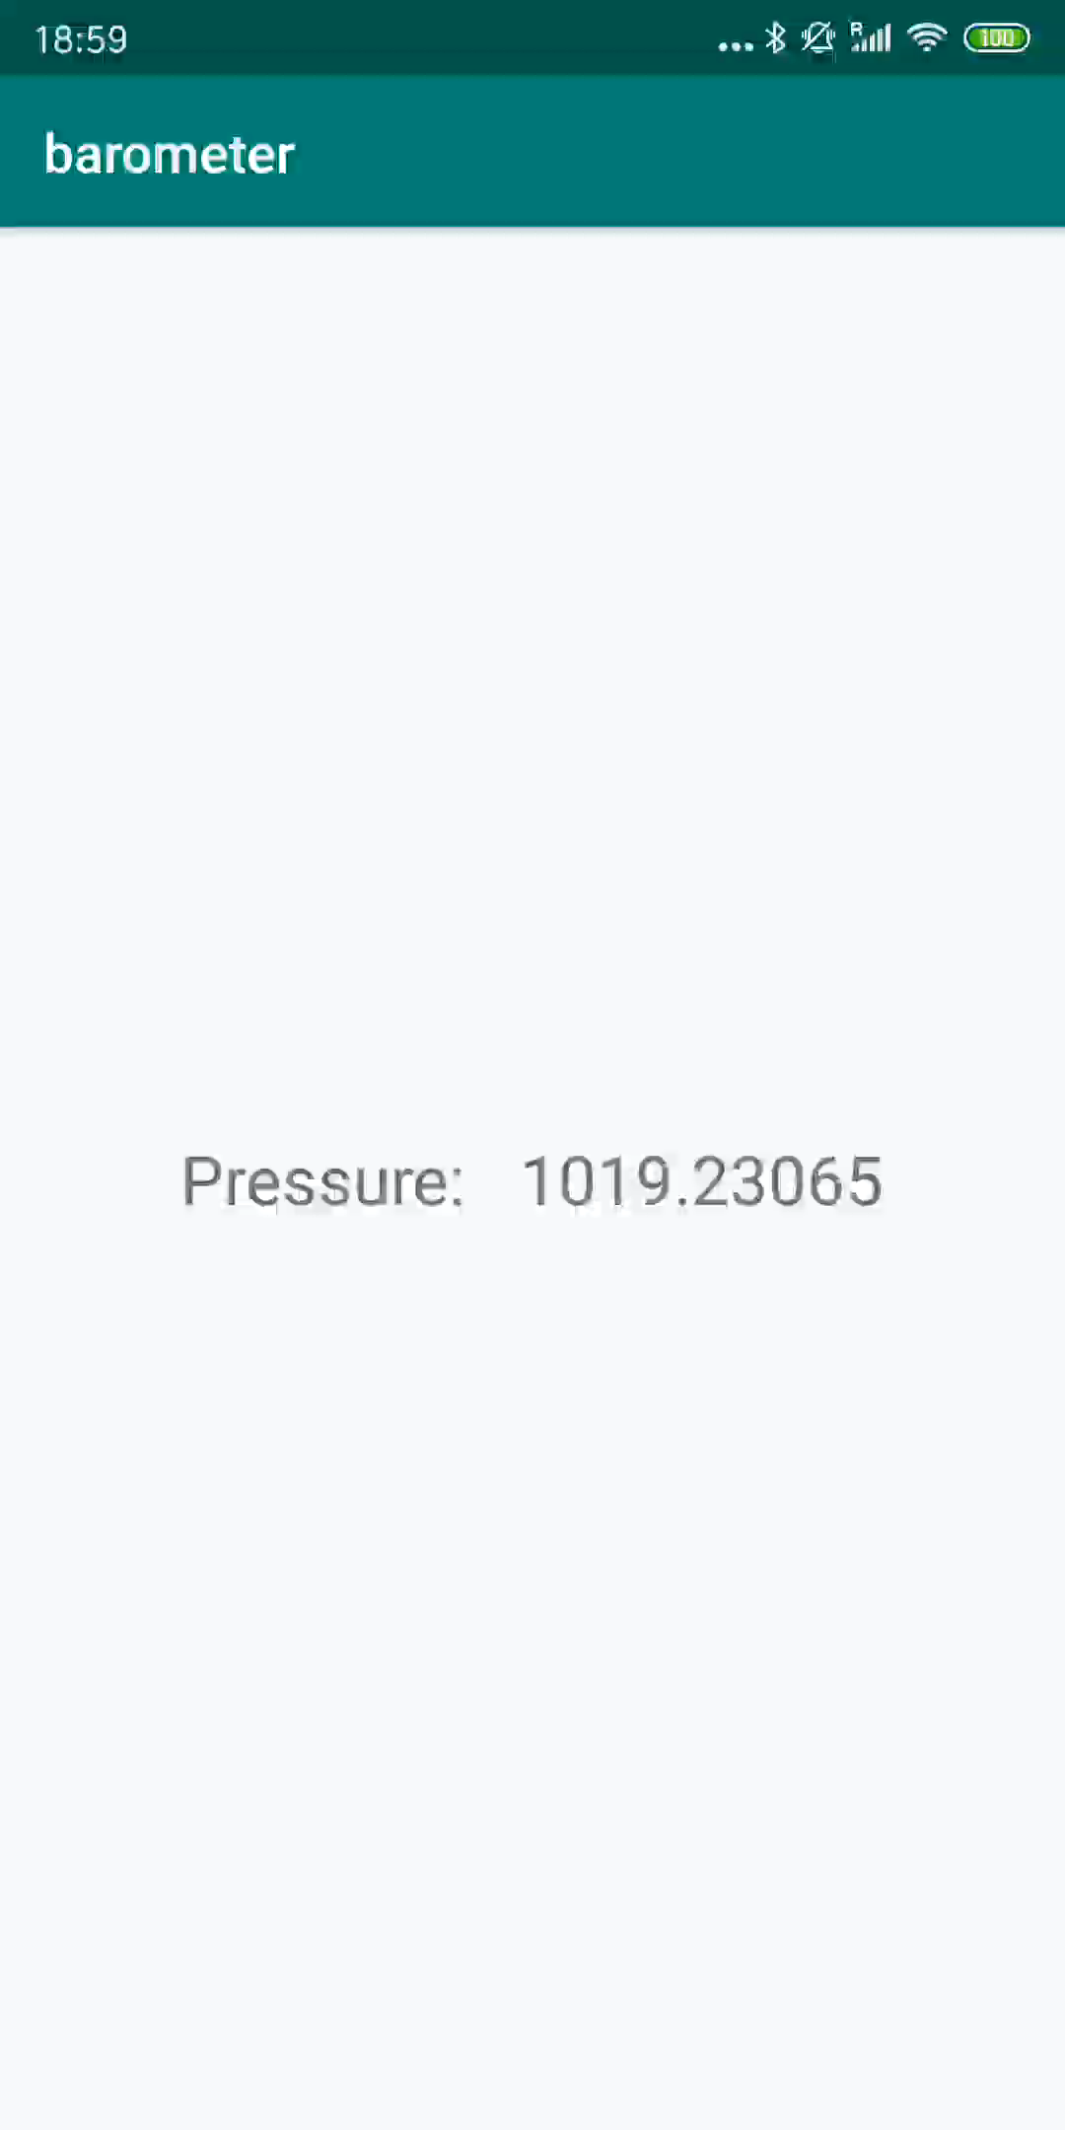
Barometer Demonstration

Slide 16
Compass
- A complete sensor-based app

Slide 17
Accelerometer
Measures the acceleration force in m/s² that is applied to a device on all three physical axes (x, y, and z), including the force of gravity.
https://developer.android.com/reference/android/hardware/Sensor.html#TYPE_ACCELEROMETER

Slide 18
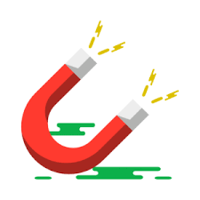
Magnetometer
Measures the ambient geomagnetic field for all three physical axes (x, y, z) in μT.
https://developer.android.com/reference/android/hardware/Sensor.html#TYPE_MAGNETIC_FIELD

Slide 19


For Reading – Calculate Acceleration
Conceptually, an acceleration sensor determines the acceleration that is applied to a device (A_{d}) by measuring the forces that are applied to the sensor itself (F_{s}) using the following relationship:
However, the force of gravity is always influencing the measured acceleration according to the following relationship:

Slide 20
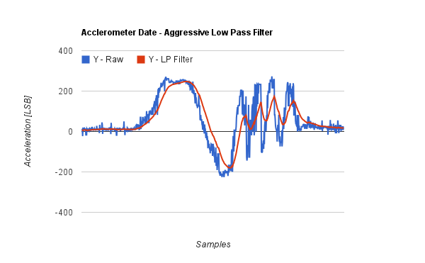
For Reading – Low-Pass Filter
A low pass filter allows the low frequencies to pass while blocking the high frequencies.
http://philstech.blogspot.com/2012/04/quadcopter-accelerometer-data-filtering.html

Slide 21
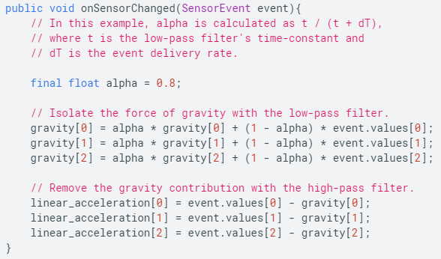
For Reading – Low-Pass/High-Pass Filter
To measure the real acceleration of the device can be achieved by applying a high-pass filter. Conversely, a low-pass filter can be used to isolate the force of gravity.
https://developer.android.com/guide/topics/sensors/sensors_motion#java

Slide 22
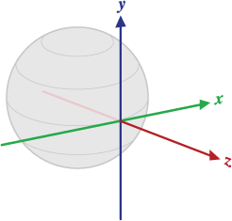
For Reading – getRotationMatrix
Computes the inclination matrix I as well as the rotation matrix R transforming a vector from the device coordinate system to the world's coordinate system.
https://developer.android.com/reference/android/hardware/SensorManager.html#getRotationMatrix(float[],%20float[],%20float[],%20float[])

Slide 23
For Reading – getRotationMatrix
R is the identity matrix when the device is aligned with the world's coordinate system, that is, when the device's X axis points toward East, the Y axis points to the North Pole and the device is facing the sky.

Slide 24
For Reading – getOrientation
Computes the device's orientation based on the rotation matrix.
https://developer.android.com/reference/android/hardware/SensorManager.html#getOrientation(float%5B%5D,%2520float%5B%5D)

Slide 25

Compass – Permission
AndroidManifest.xml

Slide 26
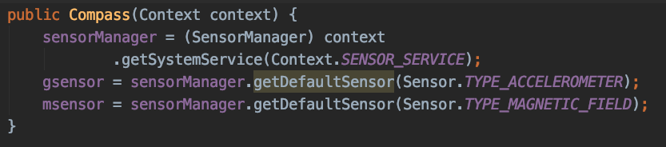
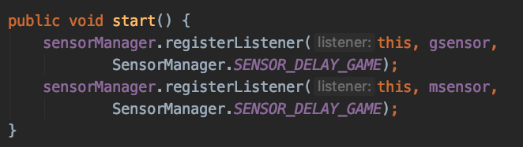

Compass – Get sensor data
Compass.java

Slide 27
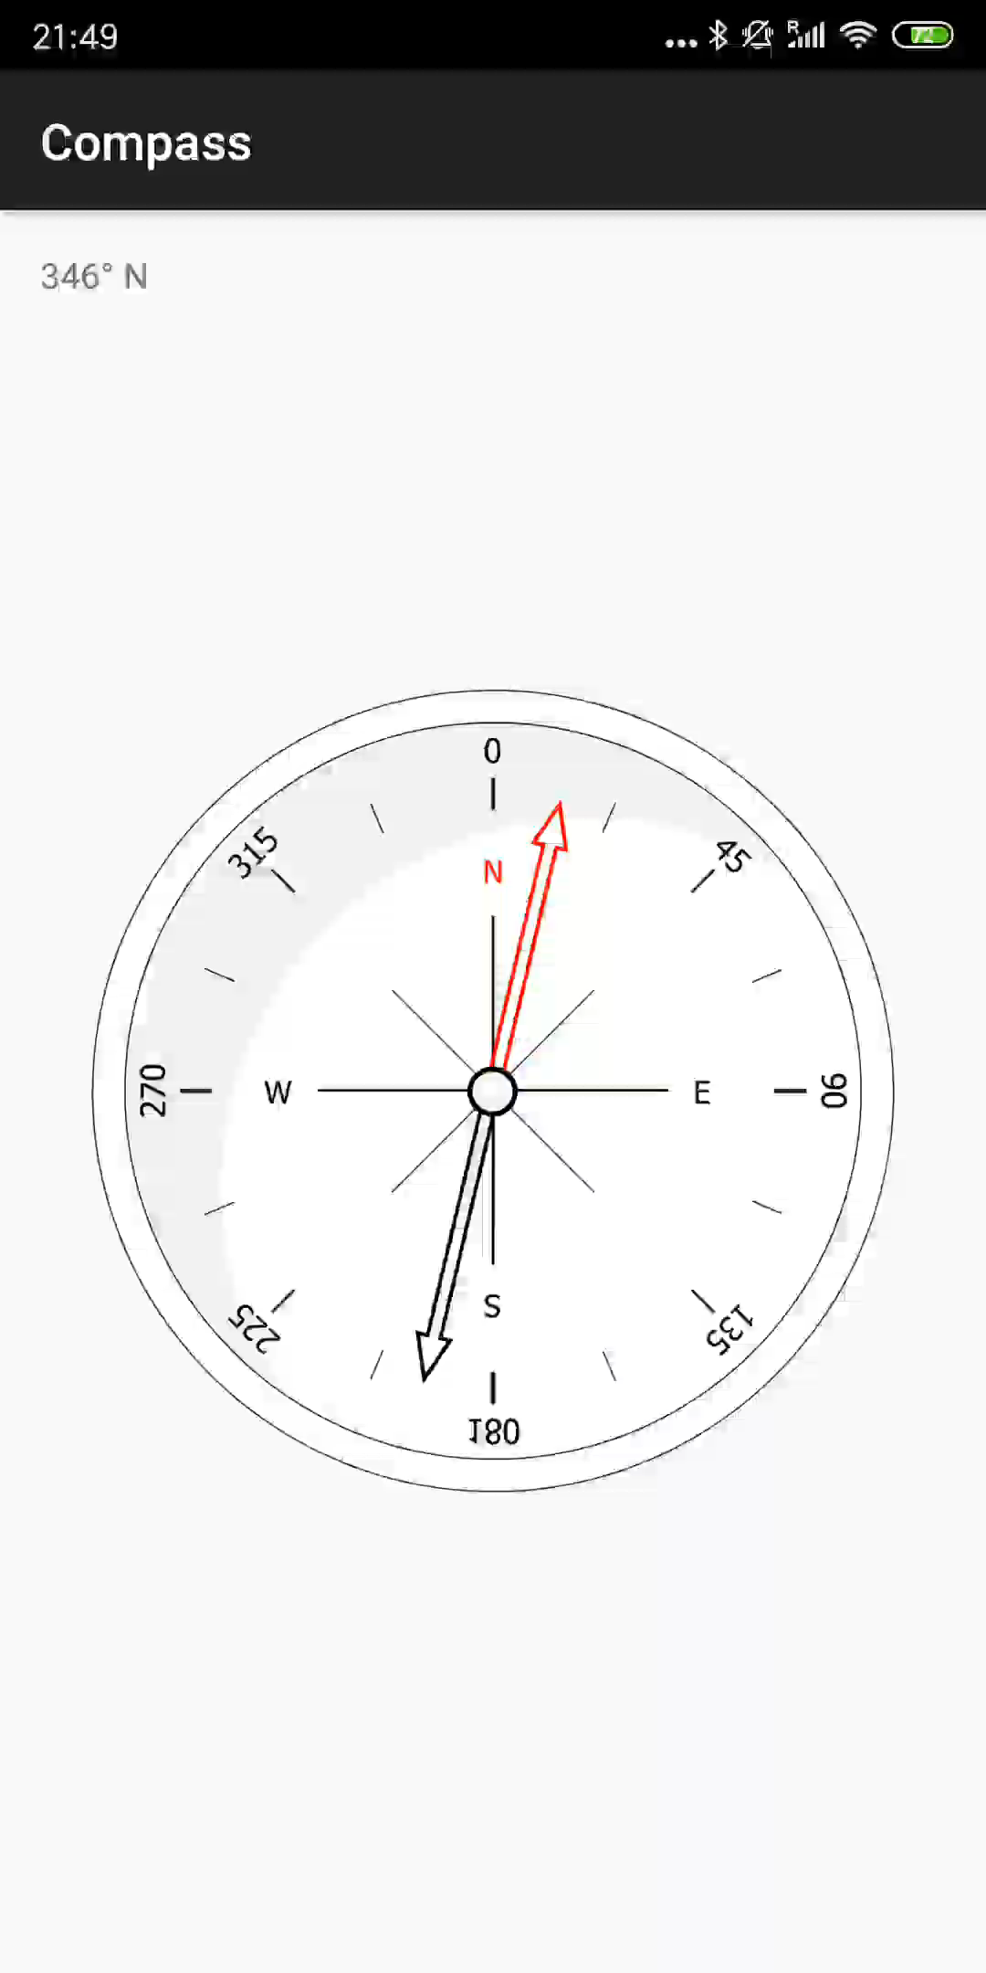
Compass – Demonstration

Slide 28
Location

Slide 29
Location
One of the unique features of mobile applications is location awareness.
Mobile users bring their devices with them everywhere, and adding location awareness to your app offers users a more contextual experience.

Slide 30
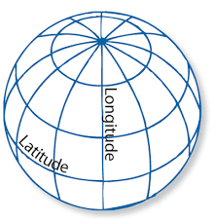
Location Demonstration – Native
Step 1:
You need a LocationManager
A Service does the low-level sensing : Context.LOCATION_SERVICE
Register a LocationListener

Slide 31
Location Demonstration – Native
Step 2 (Permission Check For Location):
Location Sensing requires Permission from users;
API 23 or above needs runtime Permission Check.

Slide 32
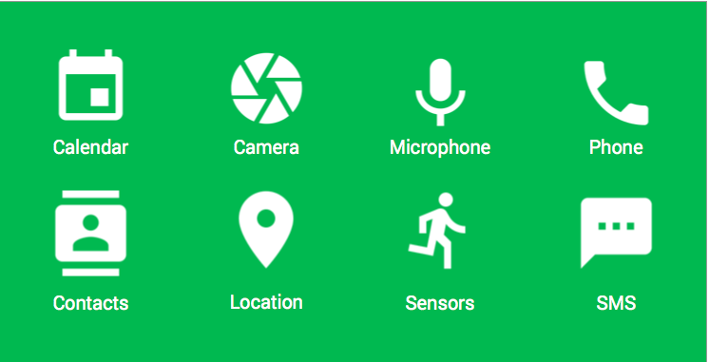
Location Demonstration – Native
Required Perimissions:
<uses-feature android:name="android.hardware.location.network" />
<uses-feature android:name="android.hardware.location.gps" />

Slide 33
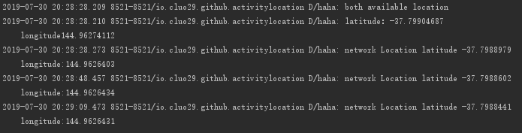
Location Demonstration – Native

Slide 34

Location Demonstration – Google API
The ApiDemos repository on GitHub includes samples that demonstrate the use of location on a map.
https://github.com/googlemaps/android-samples/blob/master/ApiDemos

Slide 35
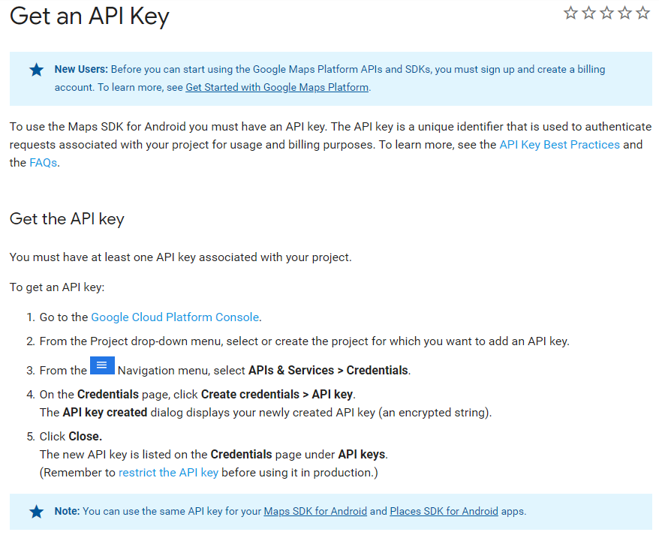
Location Demonstration – Google API
Get your own API key for Google Map API:
https://developers.google.com/maps/documentation/android-sdk/get-api-key

Slide 36
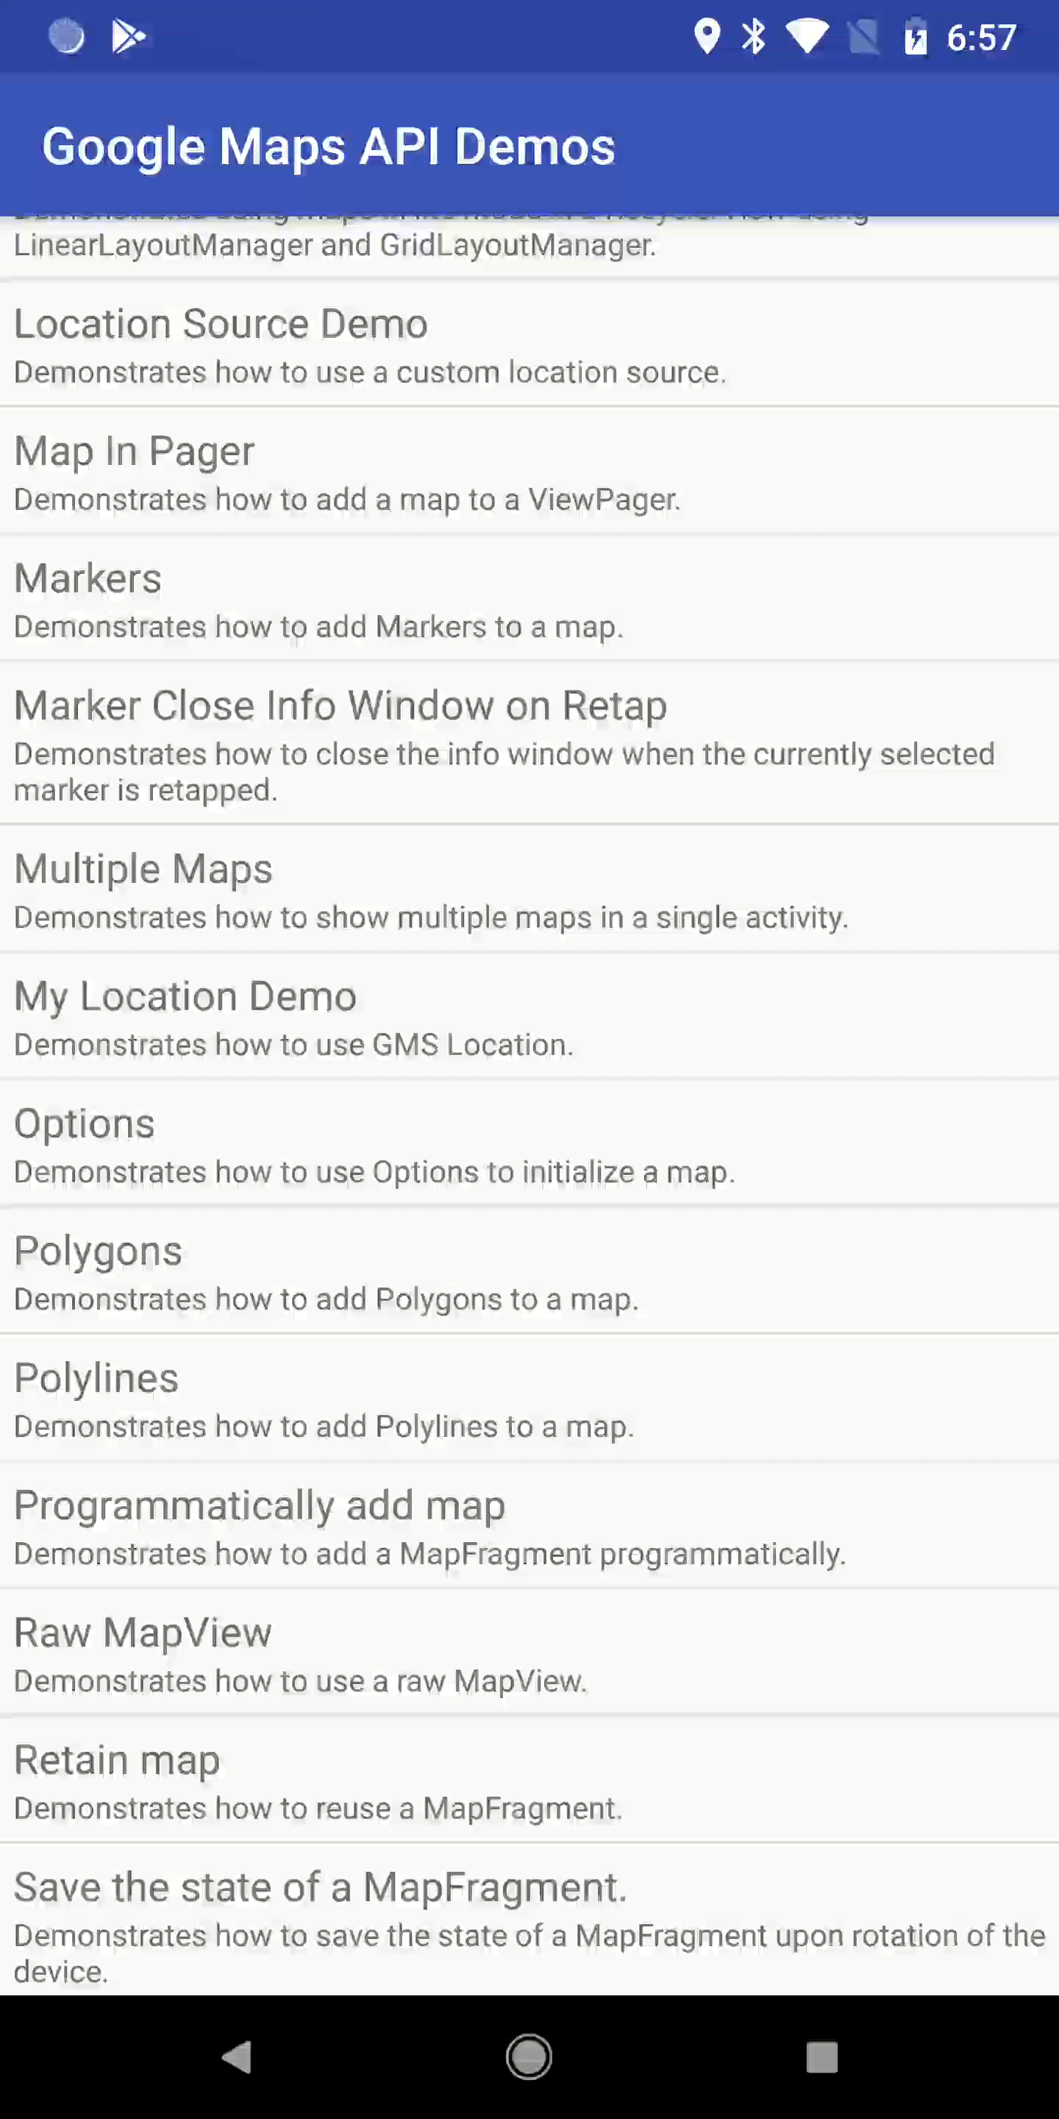
Location Demonstration – Google API

